Slide 1
Rich Mirror Alignment
23/05/2016 Claire Prouve
How does it work?
What’s new in 2016?
Current status

Slide 2
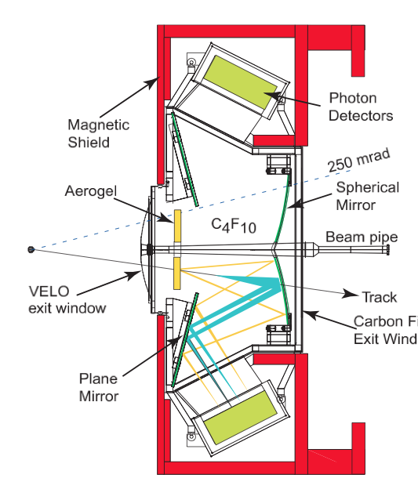
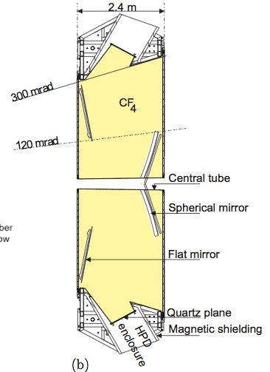
RICH Mirror Alignment
RICH 1:
RICH 2:
4 primary mirrors
16 secondary mirrors
54 primary mirrors
40 secondary mirrors
Photon Detectors
Photon Detectors
Secondary mirrors
Secondary mirrors
Primary mirrors
Primary mirrors
No more Aerogel!
x
x
Misaligned mirrors will affect the PID due to incorrectly predicted Cherenkov angle!

Slide 3
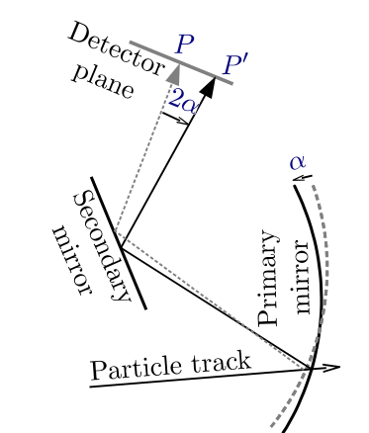
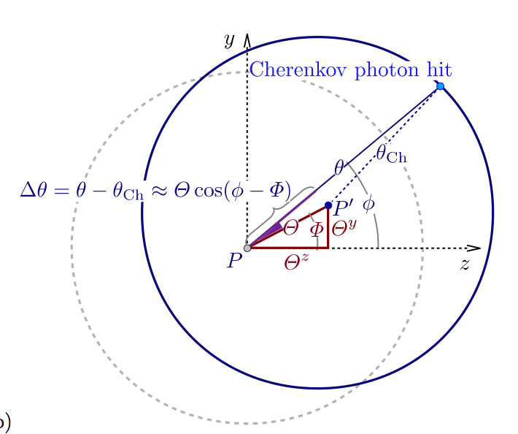
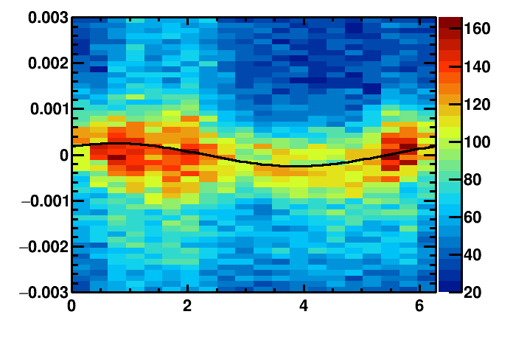
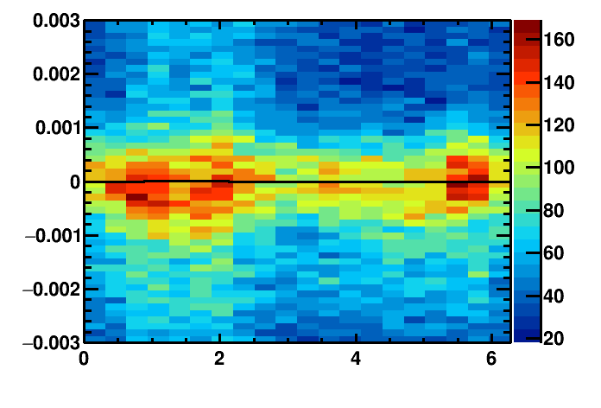
Misalignment
Detector plane
Identify misalignment:
Misalignment
Δθ_{C}(Φ) = θ_{meas.}- θ_{exp.}
Δθ_{C}(Φ) = ρ_{y} cos(Φ) + ρ_{z} sin(Φ)
Proj. Track position
Real track position
Misalignments on detector plane
Misaligned mirror:
Aligned mirror:
Cherenkov angle resolution / rad
Cherenkov angle resolution / rad
azimuthal angle/ rad
azimuthal angle/ rad

Slide 4
Overview procedure
Events from HLT1 line

Slide 5
What’s new in 2016?

Slide 6
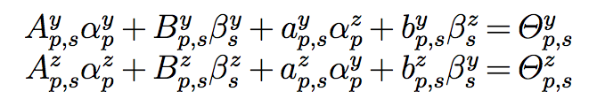
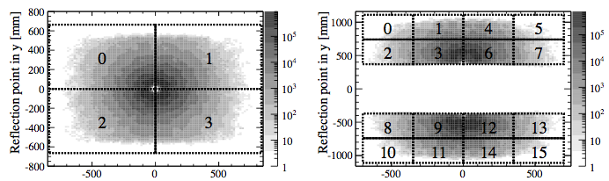
Disentangling mirror-pairs
Each pair of primary mirror p and secondary mirror s has 2 equations:
Results of fit to histogram
Magnification factors individual mirror tilts
Problem: not enough information to fully constrain the solution
RICH1: 8 equations for 10 unknowns
Rotation of primary mirrors followed by according rotation of secondary mirrors yields same results
➔ Need additional constraint
RICH1 primary mirrors
RICH1 secondary mirrors

Slide 7
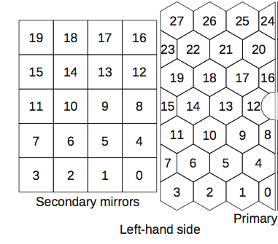
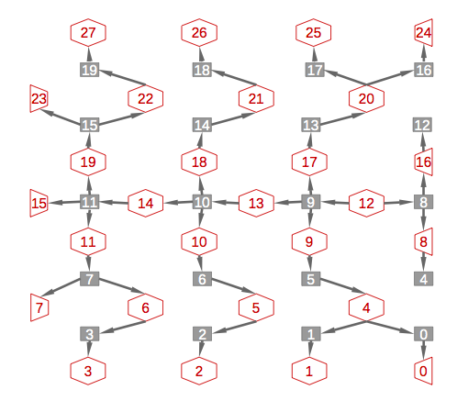
Disentangling – until 2016
Primary mirrors
Secondary mirrors
RICH1:
fix primary mirrors, align secondary mirrors
RICH2:
Left half: system of equations linking all mirrors starting from primary mirror 12.
Equivalent for right half
Andrew Cook
primary mirrors, secondary mirrors
7

Slide 8


Disentangling – from 2016
L2 regularization (ridge regression): d
rewrite problem as
Minimize least square method L2 regularization term
Advantages:
does not tend to set many x’s to zero (unlike L1 regularization)
stable (unlike L1 regularization)
more stable than the previous method
➔ Fewer iterations needed to converge
Vector of results of fit to histograms
Matrix of
magnification factors
Vector of individual mirror tilts

Slide 9
Further improvements
Magnification coefficients:
translate the misalignment-on-the-detector-plane into actual mirror tilts
Previously calculated for every alignment for each iteration on data
Tested using the same set for all alignments and all iterations
No significant difference in resulting mirror tilts and procedure 9 times faster!!!
Improved method for fitting histograms:
use same Gaussian width for each slice in phi
Same resulting mirror-tilts and 3 times faster
Δθ/ mrads
Φ angle/ rad

Slide 10
Current status

Slide 11
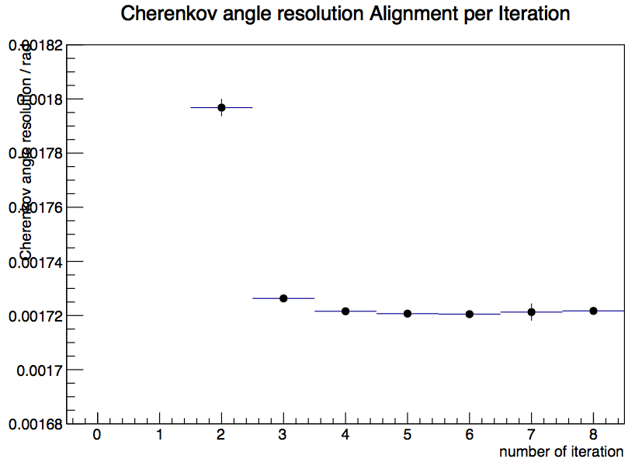
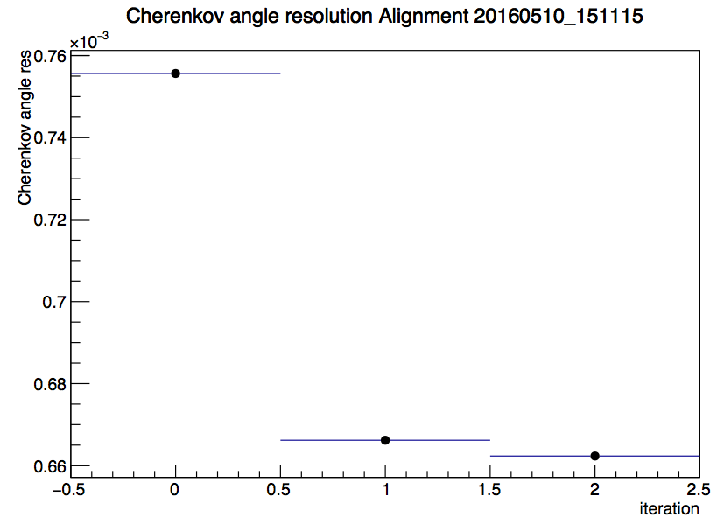
First alignment 2016
Started from completely unaligned mirrors
Calculated the magnification factors
In the global tag cond-20160517
Improvement in resolution w.r.t. last alignment: RICH1 0.1 mrad, RICH2 unchanged
RICH1 Cherenkov angle resolution per iteration of first alignment 2016
RICH2 Cherenkov angle resolution per iteration of first alignment 2016
Fluctuation of single mirror due to not-optimal data sample

Slide 12
More news & future plans
All following alignments:
Performed with all new improvements, starting from new database
Converged after first iteration
~ 6 minutes per alignment s
Alignment will be run for each fill to monitor behavior over time
Tune scale factors for RICH1 HLT1 line
Update to AlignmentOnline v11 (use newest Brunel version)
Monitoring (most parts done, need to be put together when Roel is ready)
Parallelize the fits
Tune the factor in front of the regularization term

Slide 13
Some plots
RICH1 previous alignment
RICH1 new alignment
σ_{θ} = 1.88 mrad
(no HPD corrections)
σ_{θ} = 1.76 mrad
(no HPD corrections)
Chris Jones
Chris Jones

Slide 14
Backup

Slide 15
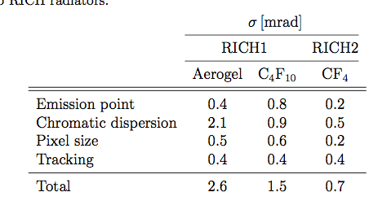
Cherenkov angle resolution
Limiting factors to Cherenkov angle resolution:

Slide 16
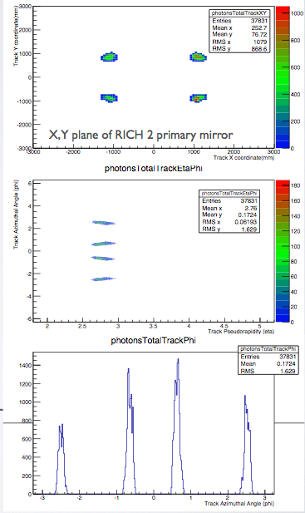
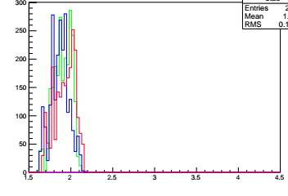
New HLT Lines
Trigger on tracks that will populate the hardest-to-populate mirror-pairs
usually the very outer mirrors
Other tracks in the events will populate the rest
RICH2
Track azimuthal angle / rad
RICH2 line:
p > 40 GeV && χ² < 2 && 2.65 < η < 2.80
(-2.59 < Φ < -2.49) || ( -0.65 < Φ < -0.55) || (0.45 < Φ < 0.65) || (2.49 < Φ < 2.59)
Track pseudorapidity
RICH1
RICH1 line:
p > 10 GeV && χ² < 2 && 1.6 < η < 2.04
(-2.65 < Φ < -2.3) || (-0.8 < Φ < -0.5) || (0.5 < Φ < 0.8) || (2.3 < Φ < 2.65)
Need to reconstruct ~10 times less events!
Track pseudorapidity

Slide 17



Magnification coefficients
Magnification coefficients: Translate the tilt on the detector plane into actual mirror tilts
Magnification coefficients are calculated new for each iteration:
Introduce 8 rotations: primary and secondary mirrors rotated around ±y and ±z axis respectively
Rotate about 0.3 mrad ( half the resolution of RICH2)
Reconstruct events for each rotation and evaluate the tilts on the detector plane
Need to reconstruct all events 9 times!
Misalignments on detector plane
Mirror tilts

